Slide 1

7COM1079-2022 Student Group No: A081 Names of Student Attendees : Lakshmi Venkata Sai Pampana,
Sai Mithil Kancharla
Gopi Krishna Malle
Karthik Kumar Elluru
Lal John Basha Shaik
Group Id: A081 Name of Student Presenting: Lakshmi Venkata Sai Pampana
Visualization and Analysis
Tutorial Presentation for Feedback Date : 18 Nov 2024

Slide 2
2
Literature Review-Key Studies:
Fan et al. (2023) – "Use of Charitable Food Assistance"
Focus on food assistance in low-income households.
Key takeaway: Statistical methods help analyze poverty reduction.
Blokhin et al. (2023) – "Hypothesis Testing Using R"
Guide on hypothesis testing using R.
Key takeaway: Practical examples of statistical tests for social issues.
Walker (2019) – "Hypothesis Tests"
Review of hypothesis testing and p-value interpretation.
Key takeaway: Helped in choosing the right tests for analyzing poverty data.
Notes:
2

Slide 3
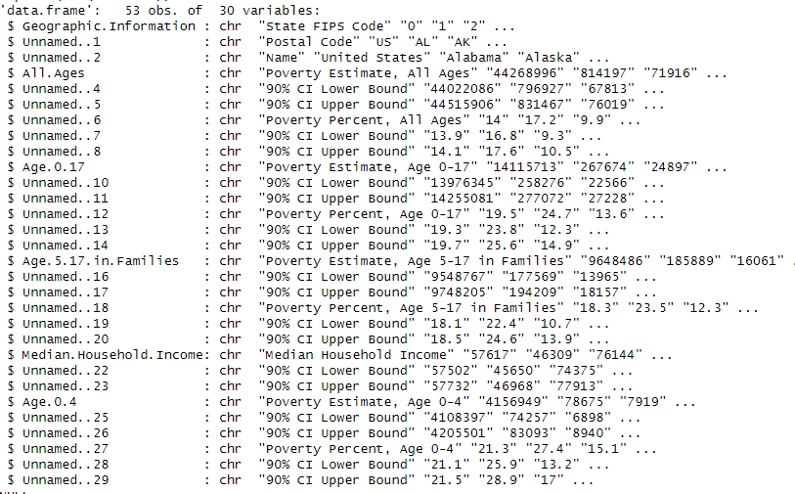
3
We are using the dataset est16us.csv to answer our Research question “Is there a difference in the mean poverty percentage for children ages 0-17 between California and Texas?”
The dataset has 30 Variables
Dependent Variable: Poverty Rate for children ages 0-17
Independent Variable: State (California vs. Texas)
Notes:
3

Slide 4
4
Methodology- Statistical Approach:
Statistical Tests
Shapiro-Wilk test for normality
Z-score analysis
Confidence interval comparison
Data Preprocessing
Cleaned and normalized data
Focused on ages 0-17
Extracted state-specific metrics
Notes:
4

Slide 5
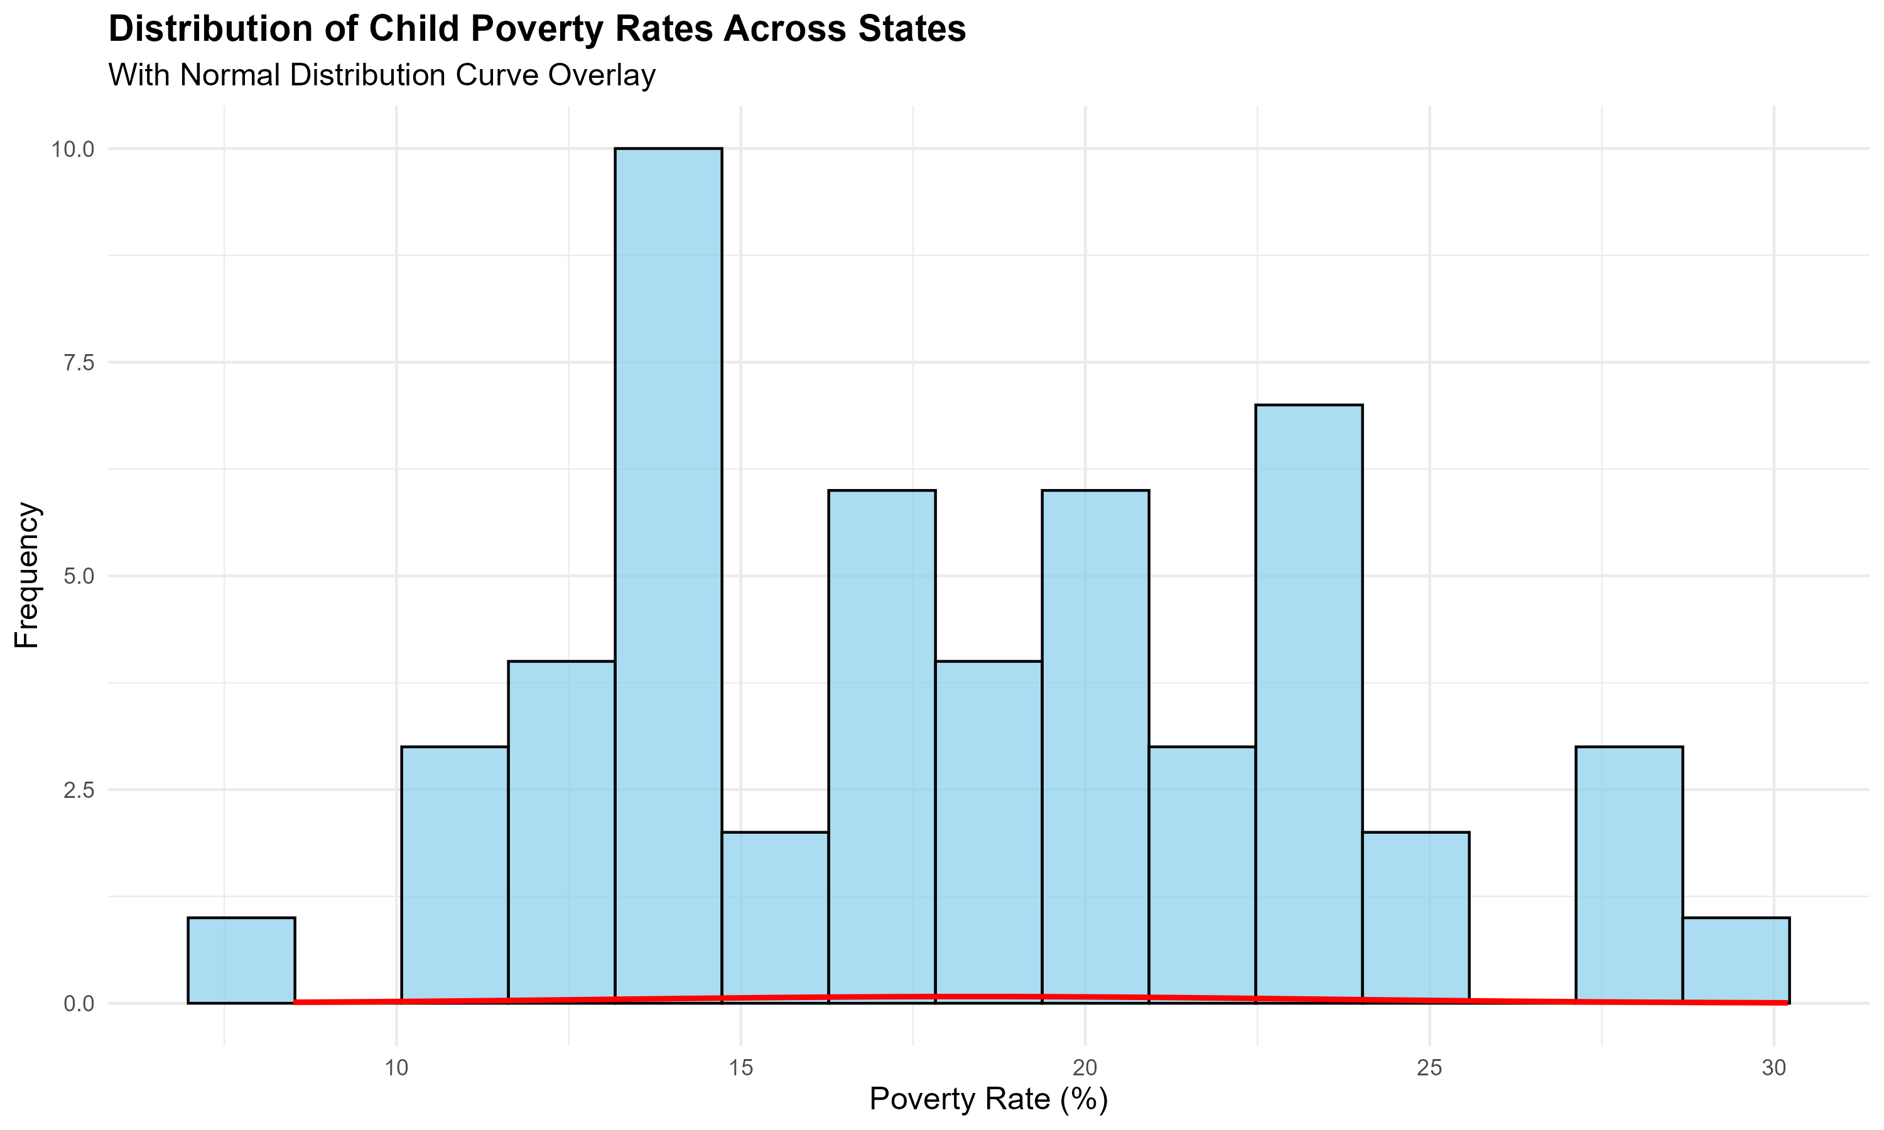
5
Distribution Analysis
Key Findings:
Normal distribution confirmed (p=0.276).
Mean poverty rate: 18.36
First quartile: 13.90%
Third quartile: 22.43%
Notes:
5

Slide 6
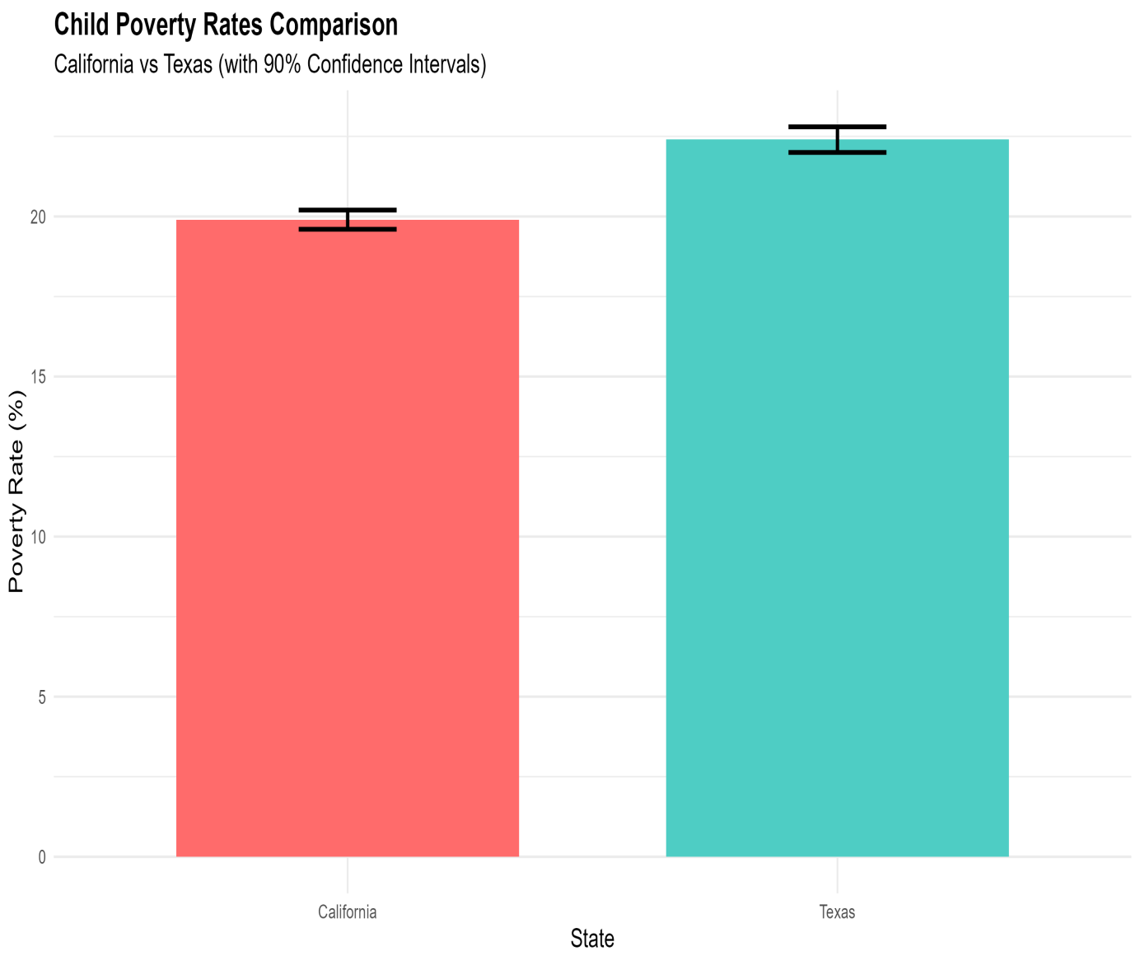
6
State Comparison
Results:
California: 19.9% (CI: 19.6%-20.2%)
Texas: 22.4% (CI: 22.0%-22.8%)
2.5 percentage point difference.
Notes:
6

Slide 7
7
Statistical Results
Interpretation:
Highly significant difference
Null hypothesis rejected
Strong statistical confidence.
Statistical Evidence:
Z-score: -8.225
P-value: < 2.2e-16
Non-overlapping confidence intervals.
Notes:
7

Slide 8
Key Findings
Research Outcomes:
Statistical Validity
Normal distribution confirmed
Robust confidence intervals
Strong statistical power
Significant State Difference
2.5% lower poverty rate in California
Statistically significant result.
8

Slide 9
Implications
Policy Implications:
Future Considerations
Cost of living adjustments
Demographic factors
Social program analysis
State-Level Impacts
Policy effectiveness differences
Social program implications
9

Slide 10
Limitations & Future Work
Limitations:
Single-year analysis (2016)
Limited demographic controls
Cost of living variations
Future Research:
Longitudinal studies
Multi-state comparisons
Policy impact analysis
Demographic breakdowns

Slide 11
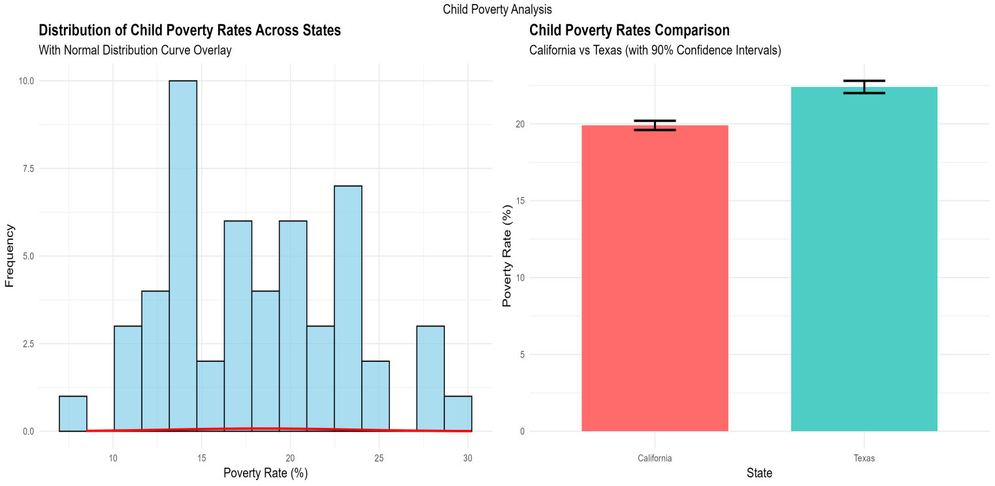
Conclusion
Summary:
Significant difference established
California shows lower poverty rate
Statistical validity confirmed
Impact:
Policy implications identified
Framework for future research
Evidence-based insights
Team Contribution:
Robust statistical analysis
Clear visualization
Comprehensive documentation

